Slide 1
Profit Maximization in Perfectly Competitive Market

Slide 2
Output Decisions: Revenues, Costs, and Profit Maximization
Perfect Competition
perfect competition An industry structure in which there are many firms, each small relative to the industry, producing identical products and in which no firm is large enough to have any control over prices. In perfectly competitive industries, new competitors can freely enter and exit the market.
homogeneous products Undifferentiated products; products that are identical to, or indistinguishable from, one another.

Slide 3
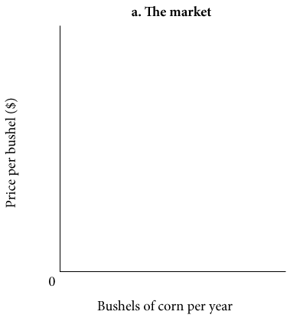
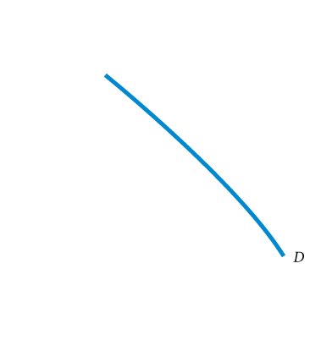
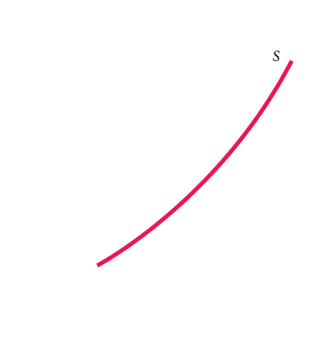
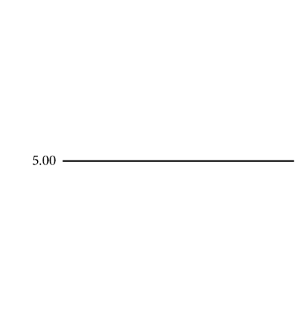
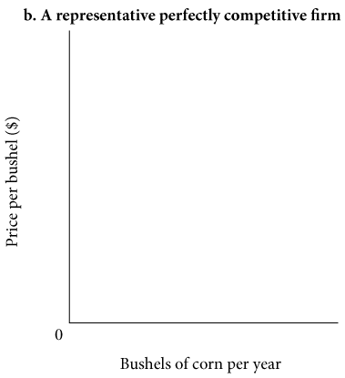
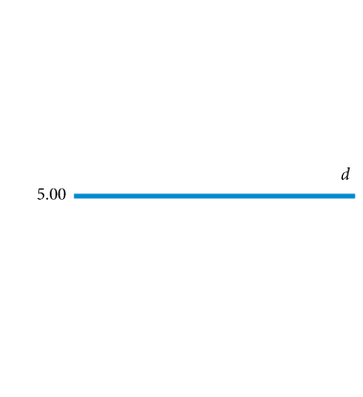
① FIGURE 8.9 Demand Facing a Single Firm in a Perfectly Competitive Market
If a representative firm in a perfectly competitive market raises the price of its output above $5.00, the quantity demanded of that firm’s output will drop to zero.
Each firm faces a perfectly elastic demand curve, d.

Slide 4

Total Revenue and Marginal Revenue
total revenue (TR) The total amount that a firm takes in from the sale of its product: the price per unit times the quantity of output the firm decides to produce (P x q).
marginal revenue (MR) The additional revenue that a firm takes in when it increases output by one additional unit. In perfect competition, P = MR.
The marginal revenue curve and the demand curve facing a competitive firm are identical. The horizontal line in Figure 8.9(b) can be thought of as both the demand curve facing the firm and its marginal revenue curve:

Slide 5
The Profit-Maximizing Level of Output
As long as marginal revenue is greater than marginal cost, even though the difference between the two is getting smaller, added output means added profit. Whenever marginal revenue exceeds marginal cost, the revenue gained by increasing output by 1 unit per period exceeds the cost incurred by doing so.
The profit-maximizing perfectly competitive firm will produce up to the point where the price of its output is just equal to short-run marginal cost—the level of output at which P* = MC.
The profit-maximizing output level for all firms is the output level where MR = MC.
In perfect competition, however, MR = P, as shown earlier. Hence, for perfectly competitive firms, we can rewrite our profit-maximizing condition as P = MC.
Important note: The key idea here is that firms will produce as long as marginal revenue exceeds marginal cost.

Slide 6
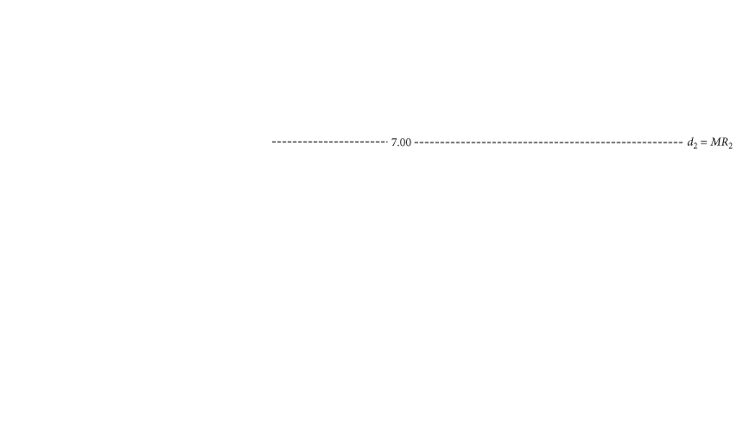
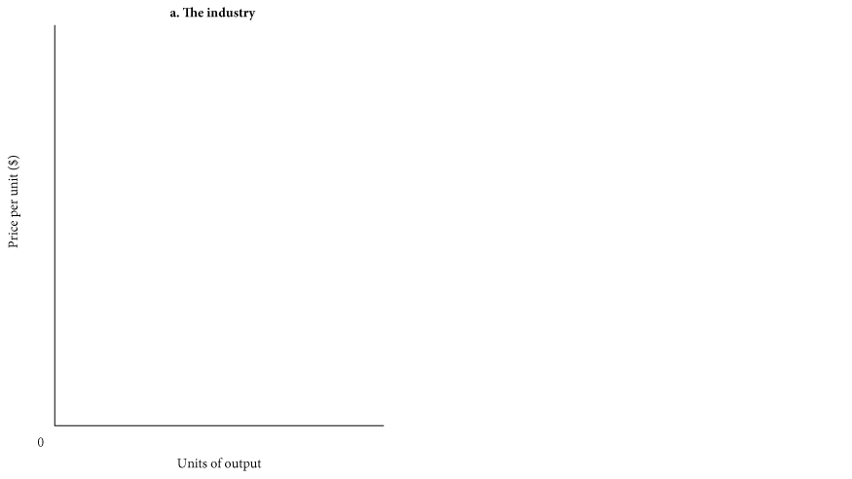
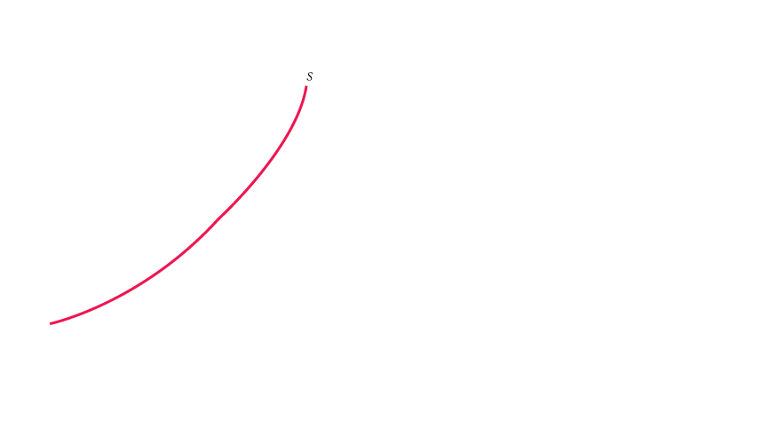
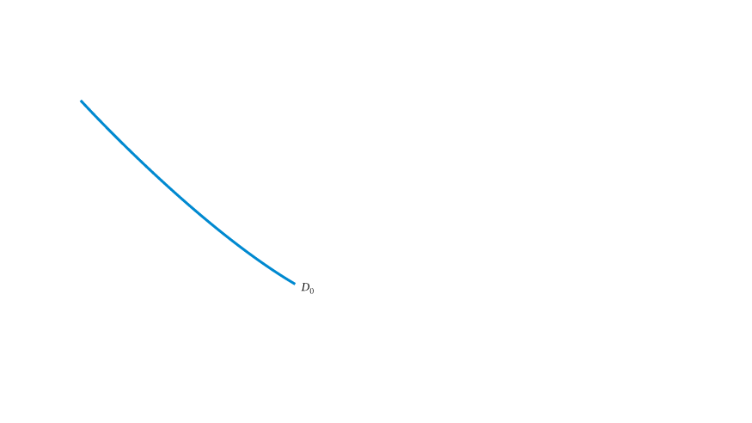
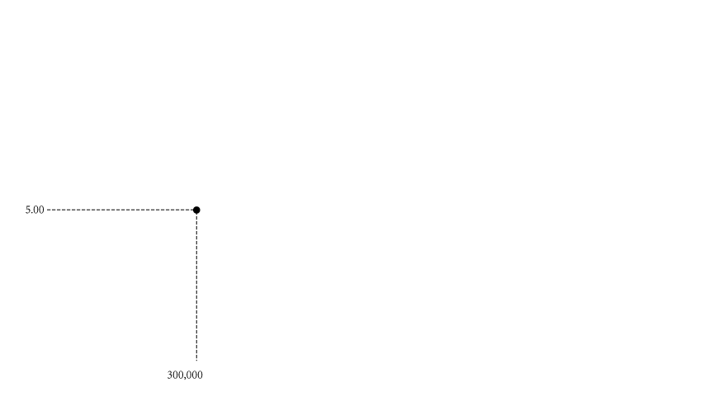
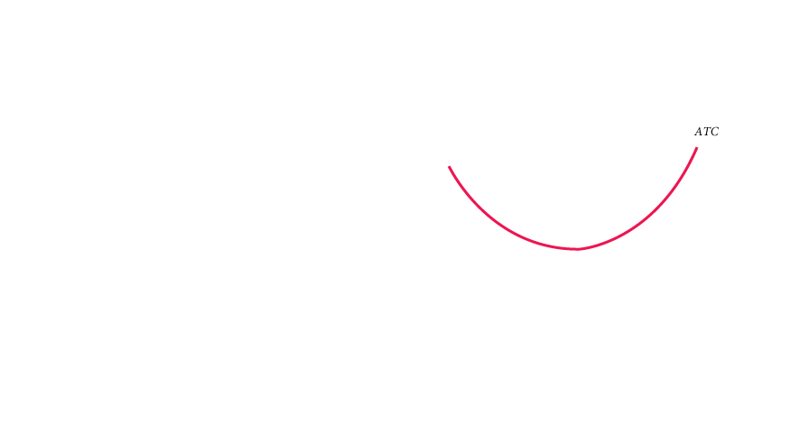
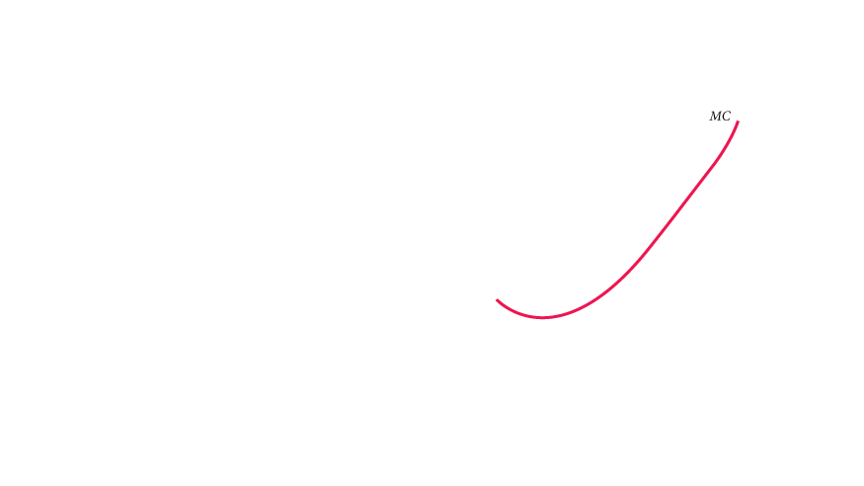
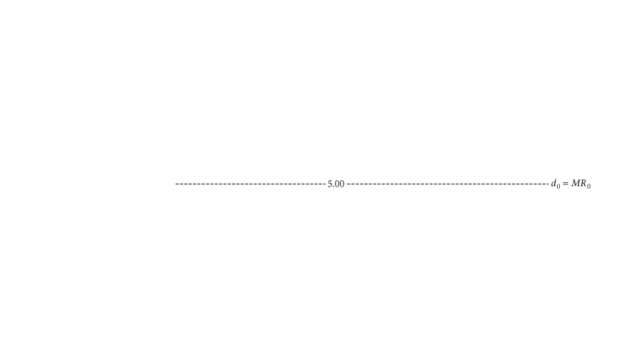
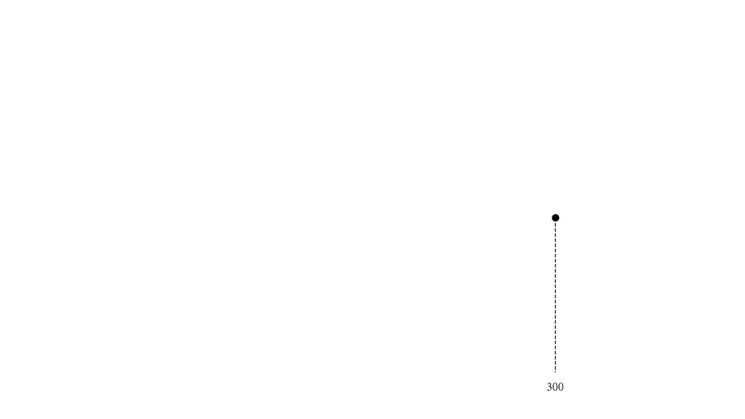
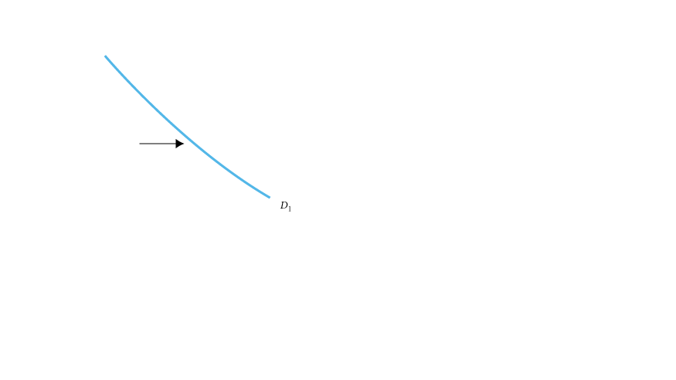
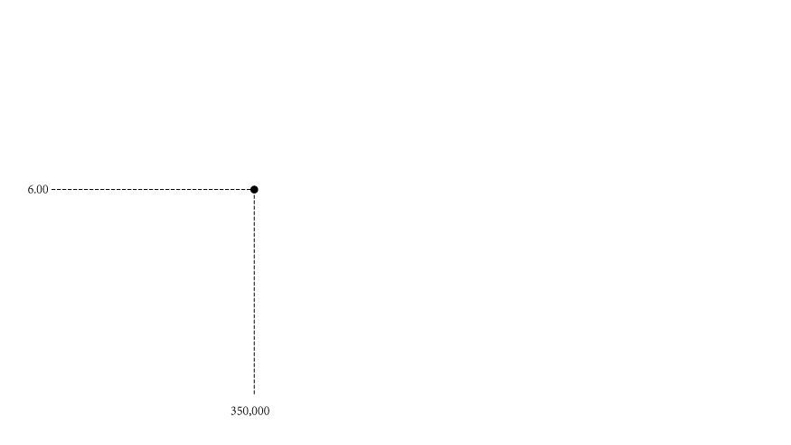
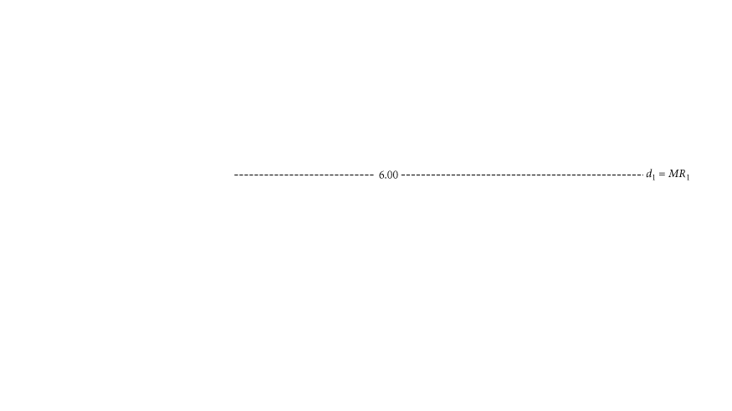
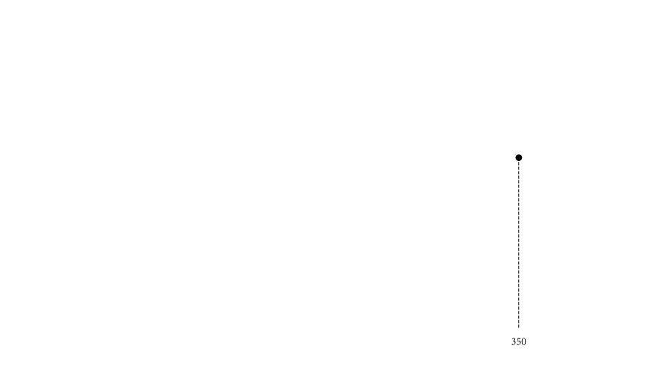
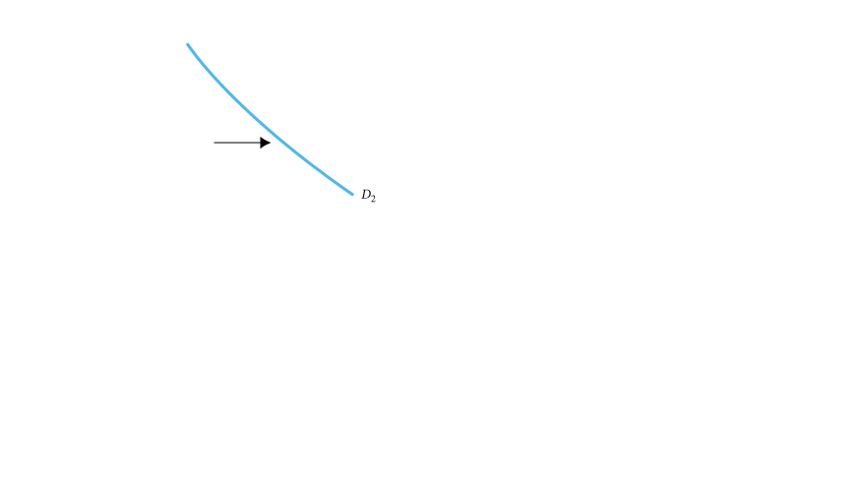
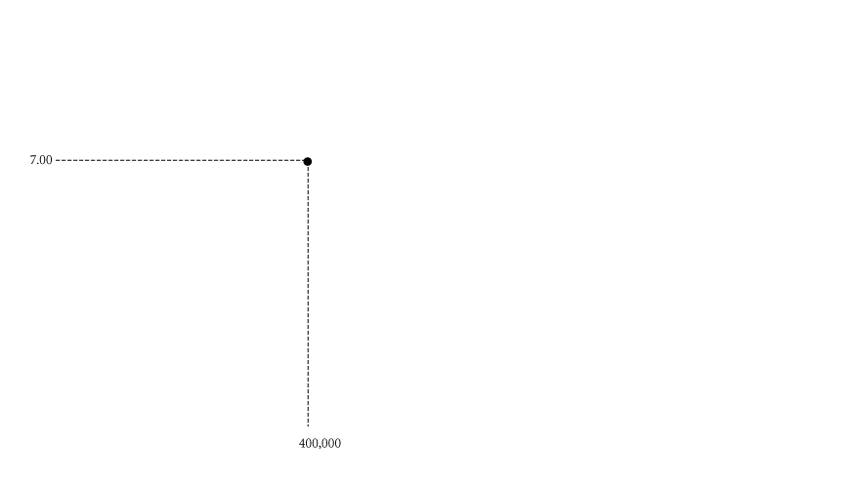
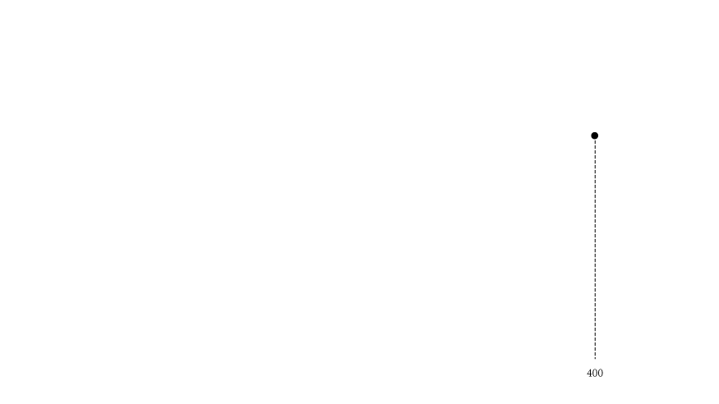
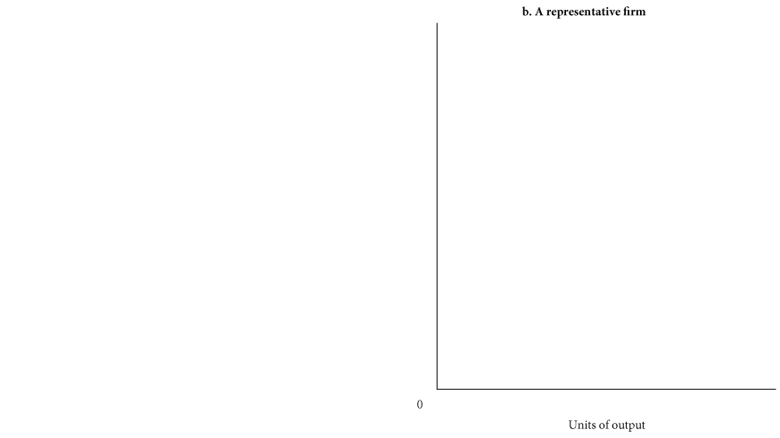
The Short-Run Supply Curve
At any market price, the marginal cost curve shows the output level that maximizes profit.
Thus, the marginal cost curve of a perfectly competitive profit-maximizing firm is the firm’s short-run supply curve.

Slide 7
Minimizing Losses
■ If total revenue exceeds total variable cost, the excess revenue can be used to offset fixed costs and reduce losses, and it will pay the firm to keep operating.
■ If total revenue is smaller than total variable cost, the firm that operates will suffer losses in excess of fixed costs. In this case, the firm can minimize its losses by shutting down.
Producing at a Loss to Offset Fixed Costs
shutdown point The lowest point on the average variable cost curve. When price falls below the minimum point on AVC, total revenue is insufficient to cover variable costs and the firm will shut down and bear losses equal to fixed costs.

Slide 8
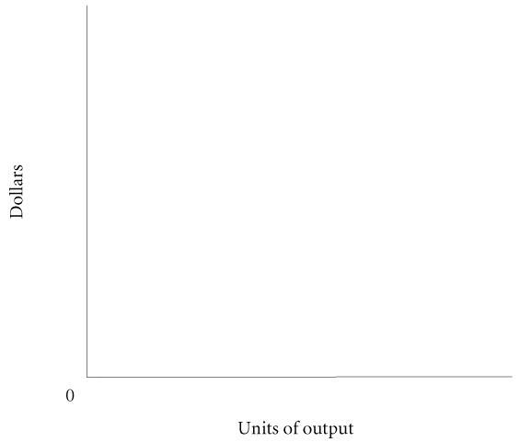
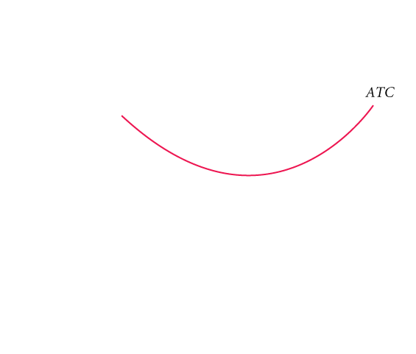
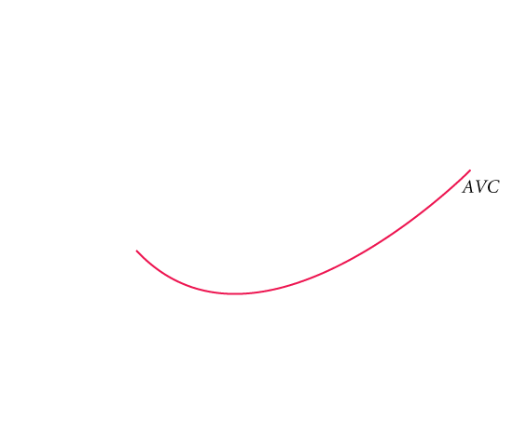
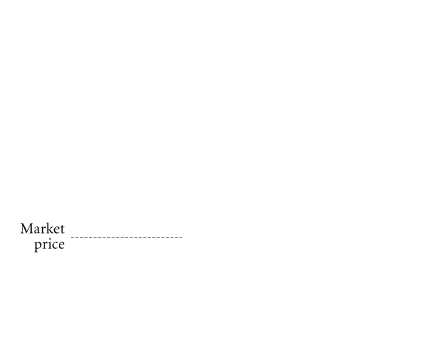
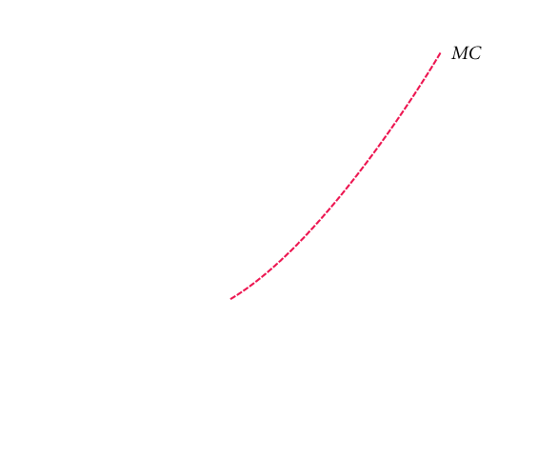

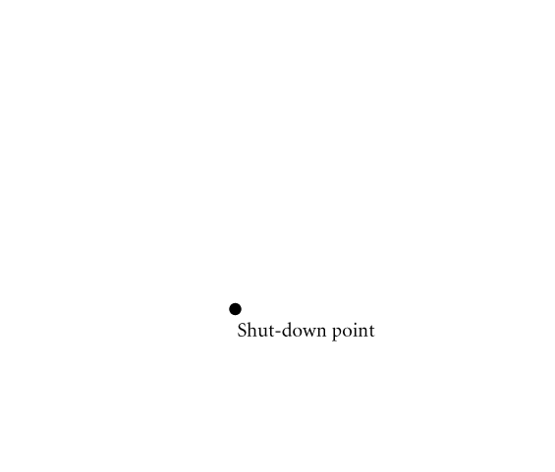
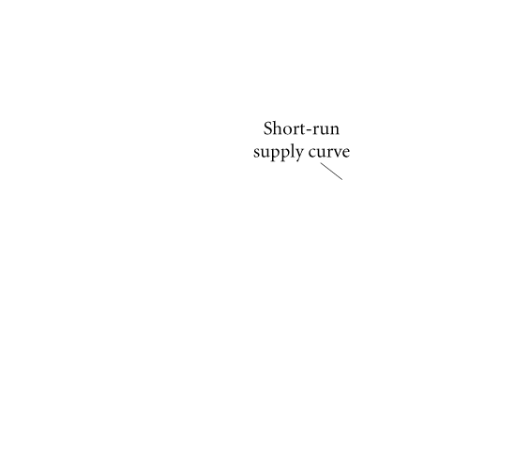
① FIGURE 9.2 Short-Run Supply Curve of a Perfectly Competitive Firm
At prices below average variable cost, it pays a firm to shut down rather than continue operating.
Thus, the short-run supply curve of a competitive firm is the part of its marginal cost curve that lies above its average variable cost curve.

Slide 9
Long-Run Directions: A Review
TABLE 9.2 Profits, Losses, and Perfectly Competitive Firm Decisions in the Long and Short Run
 |  | Short-Run Condition |  |  | Short-Run Decision |  |  | Long-Run Decision
Profits |  | TR > TC |  |  | P = MC: operate |  |  | Expand: new firms enter
Losses |  | 1. TR ≥ TVC |  |  | P = MC: operate |  |  | Contract: firms exit
 |  |  |  |  | (loss < total fixed cost)
 |  | 2. TR < TVC |  |  | Shut down: |  |  | Contract: firms exit
 |  |  |  |  | loss = total fixed cost

Slide 10
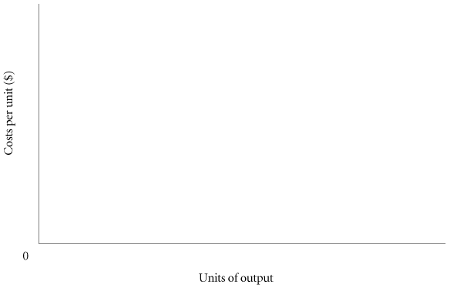
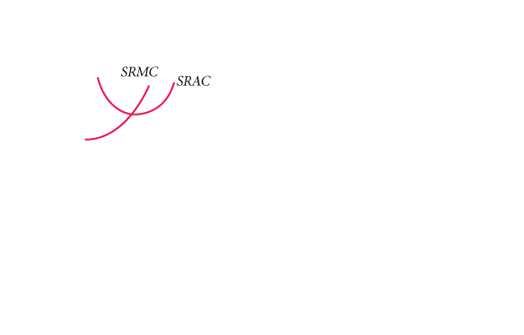
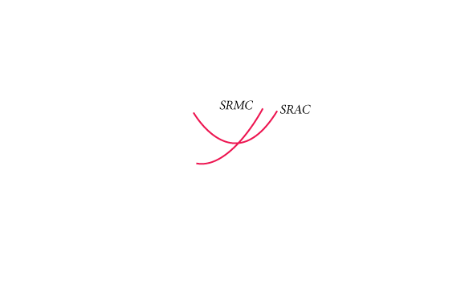
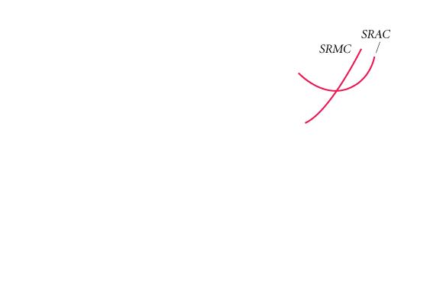
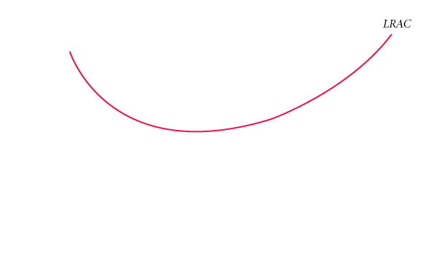
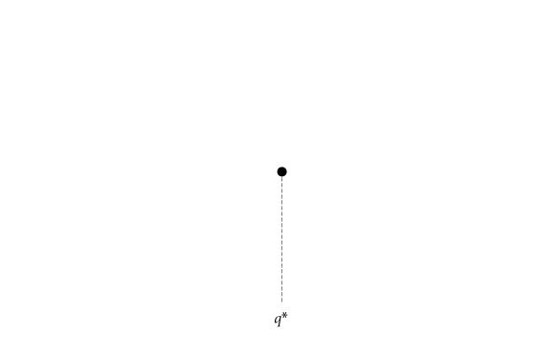
U-Shaped Long-Run Average Costs
① FIGURE 9.5 A Firm Exhibiting Economies and Diseconomies of Scale
Economies of scale push this firm’s average costs down to q*.
Beyond q*, the firm experiences diseconomies of scale;
q* is the level of production at lowest average cost, using optimal scale.
optimal scale of plant The scale of plant that minimizes average cost.

Slide 11
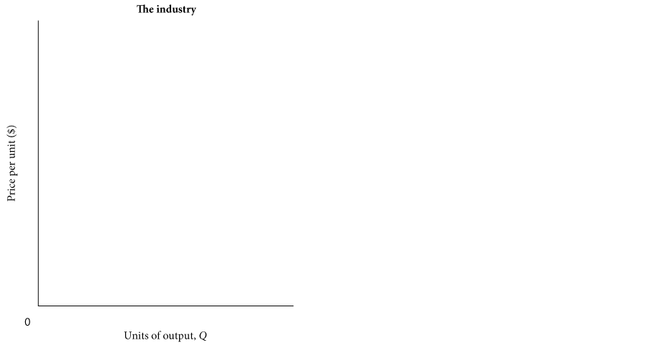
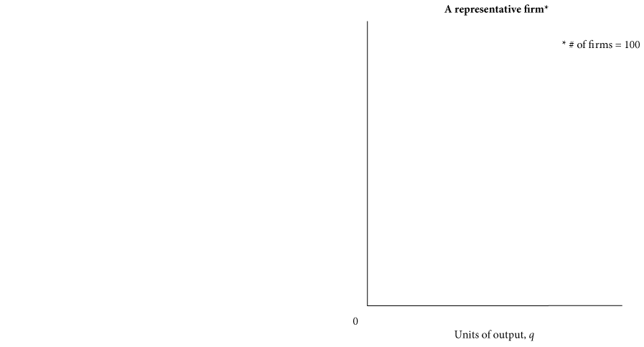
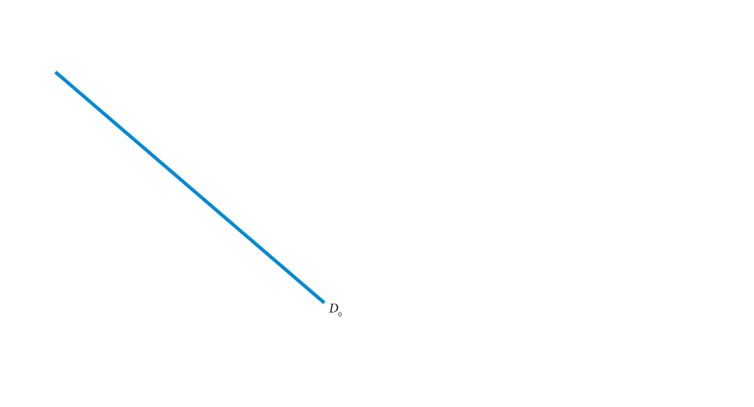
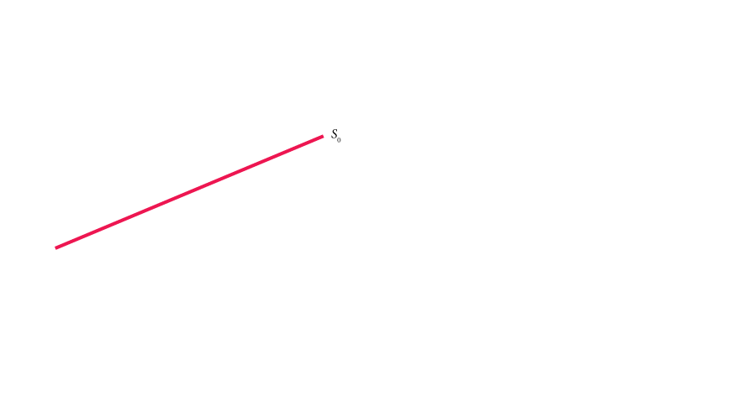
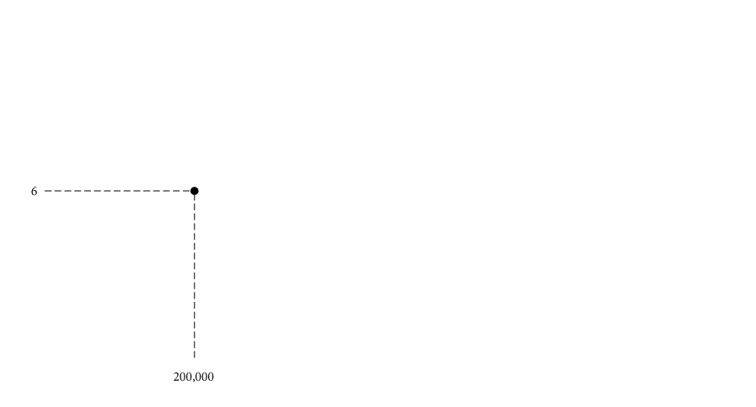
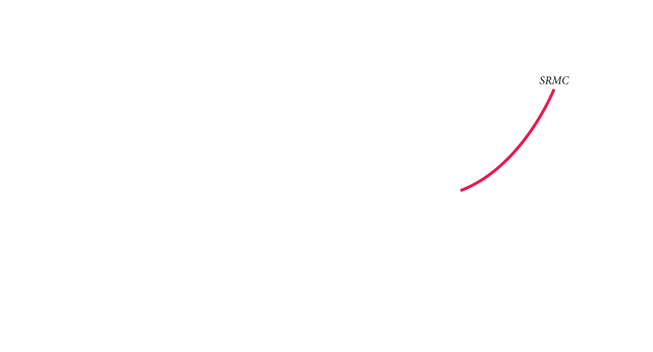
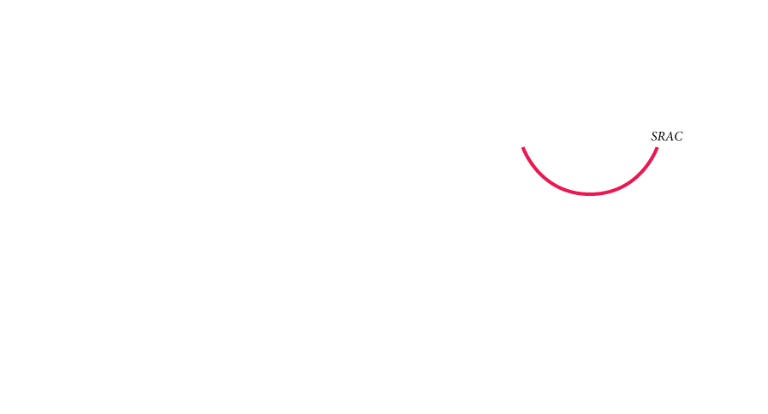
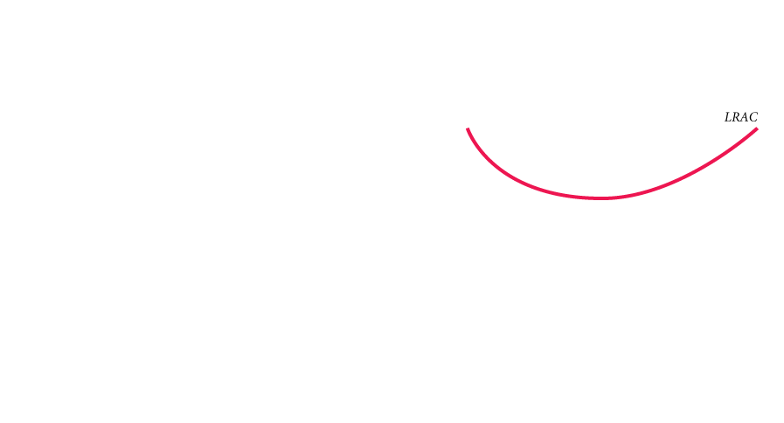
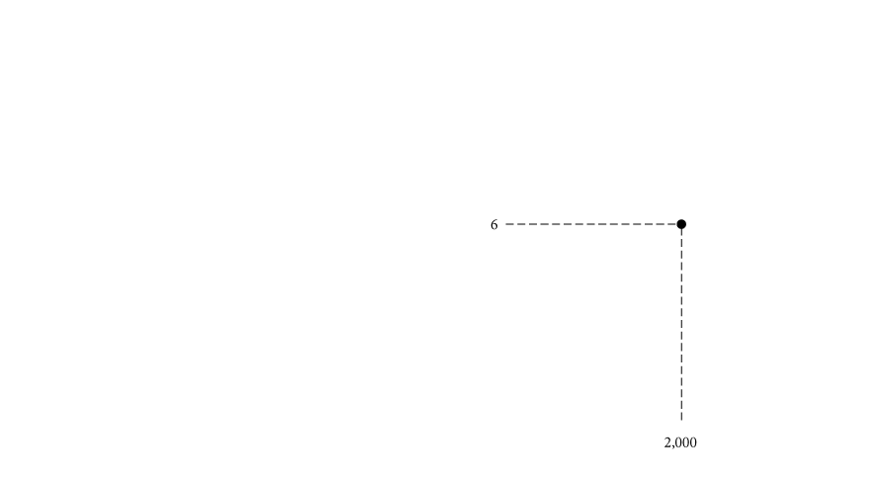
Long-Run Adjustments to Short-Run Conditions
Short-Run Profits: Moves In and Out of Equilibrium
① FIGURE 9.6 Equilibrium for an Industry with U-shaped Cost Curves

Slide 12
In equilibrium, each firm has
SRMC = SRAC = LRAC
Firms make no excess profits so that
P = SRMC = SRAC = LRAC
and there are enough firms so that supply equals demand.

Slide 13
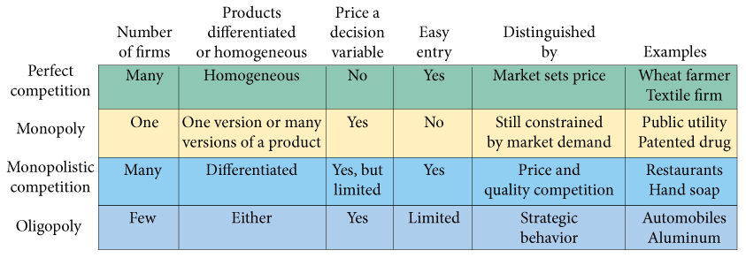
② FIGURE 15.1 Characteristics of Different Market Organizations

